Slide 1
High School Math Teacher – Cobb County AND Part-time Tutor
Annual Starting Salary - $42,427.00
-Tutoring income $8,320
- Teaching income $34,427
Pre-Tax Monthly Salary: $3,535.58
Less: Taxes at 28.8%
($3,535.58 * .288) = $1,018.25
Take home Salary: $2,517.33

Slide 2
4-year cost: $ 74,721.60
Less: Armed Forces Scholarship: $8,000
Total loan- $ $66, 721.60
Loans:
Direct Subsidized
Plus Loan
Amount | Time | Interest Rate | Compounded
$27,000 | 10 yrs (120 months) | 4.66% | monthly
Federal Loan Payment: $281.91
Amount | Time | Interest Rate | Compounded
$39,721.60 | 25 years (300 months) | 4.292% | monthly
Plus Loan Payment: $230.36
Total loan payments:
First 10 years: 512.27 Last 15 years: $230.36

Slide 3
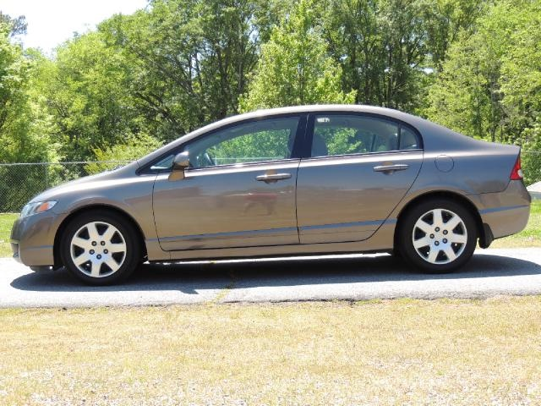
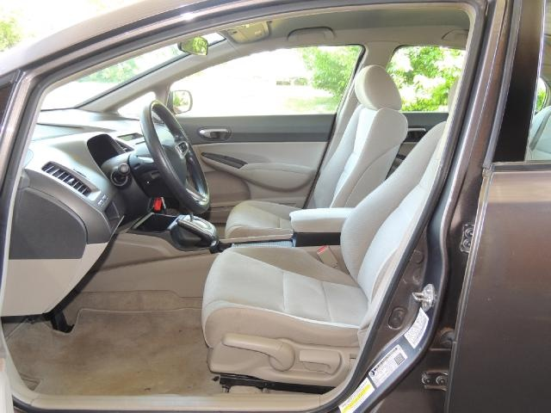
2011 Honda Civic
Cost of car: $10,570 Monthly Payment: $187.54
Lending Bank: Bank of America
Amount | Time | Interest Rate | Compounded
$10,570 | 5 years (60 months) | 2.49% | monthly

Slide 4
Home: Address
Should include the following:
Pictures
Description
Pricing information:
Price you paid
Future value price
Terms of loan (# of years, interest rate, bank)
Monthly payments

Slide 5
Investments:
Must include the following:
Investment company
Type of investment
Interest percentage
How often does it compound
Amount of monthly deposit/payment or is it a one-time lump sum?

Slide 6
Credit Card expenses:
Type of Credit Card
Outstanding balance
Annual Interest rate
Monthly payment amount
How long will it take you to pay off?

Slide 7
Household Expenses: yours may look different according to your expenses
 | Monthly Cost | How/Where you determined cost
Cell phone
Internet
Cable
Water
Gas
Electricity
Car Insurance
Renters Insurance
Health Insurance
Food
Entertainment
Savings
Total

Slide 8
Total Monthly Expenses
Repayment of Education Loans: $ 512.27
Car payment: $ 187.54
Apartment Rent: 339.50
Household Expenses: $1,150.00
Total monthly Expenses: $2,189.31

Slide 9
What’s Left?
Post – Tax Salary: $2,517.33
Monthly Expenses: (2,189.31)
Remaining income: $328.02

Slide 10
Summary….
What did you gain?
What would you change?
What did you learn as a result….what didn’t you know about “life” before starting this project
What would you apply in real life?

